Slide 1
Waves in more than one dimension
26th october 2020

Slide 2
Plane wave representation in two and three dimensions
Basically, the plane wave representation moving in one dimension may be written as
Consider the argument representing the phase ;i.e., ωt – kx, the term kx illustrates the phase shift due to the wave displacement along the propagation direction where the wave number k = 2π/λ.
What should this term be modified to if the plane wave propagates in two or three dimensions?
To modify this term, the direction cosine has to be discussed.!

Slide 3
Direction cosine
By definition, the direction cosine or directional cosine of a vector is a cosine of the angle between the vector and the three coordinate axes.
According to the left picture, the direction cosine of the wave vector k are composed of
cos α = k₁/k and cos β = k₂/k
Cos α and cos β are represented by l and m, respectively.
“lx + my = p” represents the line equation in two dimensions where p is the perpendicular distance from the line to the origin.
β
α

Slide 4
Modified phase representation
The phase difference φ between the origin and a given line as seen from the figure in previous slide can be written as

Slide 5
Plane wave representation in 2 and 3 D
Therefore, the plane wave representation moving in 2 and 3 D can be written as

Slide 6
Equation of motion in two dimensions : Rectangular membrane
Consider the rectangular membrane of a uniform membrane vibrating in the z-direction.
Area of the membrane = δxδy. The mass of the membrane is given as ρδxδy.
Restoring forces acting on length δx and δy are given as T δy and T δx
The equation of motion for the membrane is found to be

Slide 7
Wave equation and corresponding wave function in two dimension : Rectangular membrane
Wave function that satisfies the wave equation is given as
The wave function represents the plane wave propagating in the xy plane.

Slide 8
Normal modes and the method of Separation of variables
What we are interested here is the wave function of the standing waves on the rectangular membrane.
The standing waves will be called normal modes for the rectangular membrane.
This can be found by introducing the boundary conditions at both sides of the rectangular membrane.
However, to clarify the method, the analytical procedure will begin with one dimensional standing wave happening on the string fixed at both ends.

Slide 9
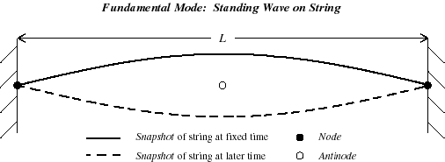
Wave function for one-dimensional case with boundary conditions
The boundary conditions for the string fixed at both ends: displacement φ = 0 at x = 0 and x = L at all times.
The wave equation is given as
A solution of the equation can be written as the product of two terms
φ = X(x)T(t).
By using the method of separation of variable,
Wave function of standing wave

Slide 10
Problem
Determine the wave function and the normal modes of vibration for the standing wave of a string fixed at both ends using the method of separation of variable.
Given that the boundary conditions : φ = 0 at x = 0 and x = L at all times.
Notes:
Normal modes of vibration = eigen frequencies

Slide 11
Wave function for one-dimensional case without boundary conditions
With the method of separation of variable, the solution of the following wave function
are found to be
A familiar form of the above function may be written as
or

Slide 12
Wave function for two-dimensional case
Under this circumstance, the wave equation is given as
Now, the function φ may be written as the product of X(x)Y(y)T(t).
With the method of separation of variable, a solution of the differential equation may be written as
Also the solution may be given as

Slide 13
Wave function for three-dimensional case
Under this circumstance, the wave equation is given as
Now, the function φ may be written as the product of X(x)Y(y)Z(z)T(t).
With the method of separation of variable, a solution of the differential equation may be written as
Also the solution may be given as

Slide 14
Normal modes in two dimensions on a rectangular membrane
Consider waves proceed in a direction k on the rectangular membrane of sides a and b.
Separation distance between each dotted line is λ/2.
Conditions for the existence of standing waves are a =n₁AA’ and b = n₂BB’, where n₁ and n₂ are integers.
From the figure
A
A’
a=n₁AA’
From definition of the directional cosine

Slide 15
From the previous slide,
This gives
Or
The normal mode (vibrating frequency) of the vibrating rectangular membrane can be written as
Notes:
สังเกตว่าในการรายงานค่า ความถี่หนึ่ง หรือ normal mode หนึ่ง ๆ ต้องมีทั้ง integer n1 และ n2
จะเรียก normal mode frequencies นี้ว่า allowed frequencies ก็ได้

Slide 16
Wave function in two dimensions on a rectangular membrane
Recall the general wave function in 2 D,
For a particular wave function that satisfies the rectangular membrane, the boundary conditions have to be considered.
Boundary conditions : z = 0 at x = 0 and a; z =0 at y = 0 and b.
So that
Direction of displacement

Slide 17
Fundamental vibration frequency and conditions for nodal lines
Recall the general normal mode frequency,
The fundamental vibration frequency is given by n₁ = n₂ = 1,
Conditions for nodal lines or zero displacement in the general mode (n₁n₂)

Slide 18
Some normal modes on a rectangular membrane

Slide 19
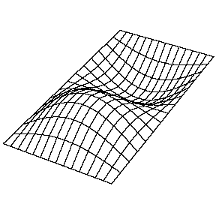
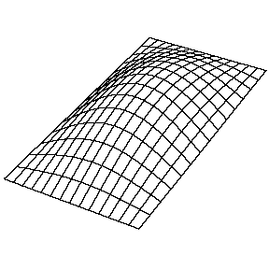
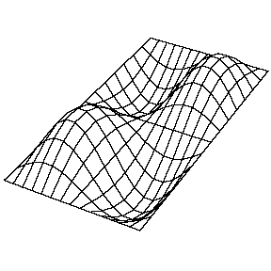
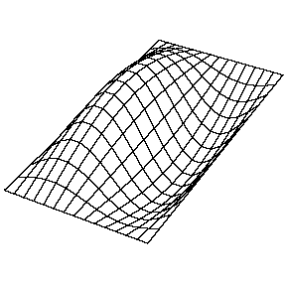
Identify the normal modes on this rectangular membrane
Y
X
The (2,1) Mode
The (1,2) Mode
The (1,1) Mode
The (2,2) Mode
For more animation please visit
https://www.acs.psu.edu/drussell/Demos/rect-membrane/rect-mem.html
http://www.acs.psu.edu/drussell/Demos/MembraneSquare/Square.html

Slide 20
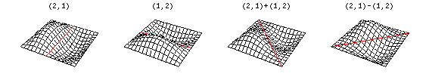
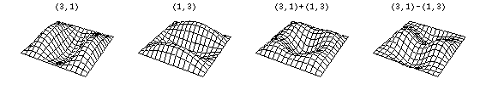
Degenerate mode for a square membrane
The (2,1) and (1,2) Modes
The (3,1) and (1,3) Modes
http://www.acs.psu.edu/drussell/Demos/MembraneSquare/Square.html
Notes:
Degenerate modes คือ modes ที่มี label n1n2 ต่างกันแต่มี normal mode vibration frequencies เท่ากัน

Slide 21
Waveguides
Now, consider a 2D wave propagating in a direction k in the xy plane along a membrane of width b stretched under a tension T between two long rigid rods which present and infinite impedance to the wave.
The displacement z is given by the superposition of the incident and reflected waves (why?),

Slide 22
Displacement of the wave on the membrane
Recall the superposition from the previous slide,
Consider the boundary conditions :z = 0 at y= 0 and y =b (the positions of infinite impedance).
This gives A₂ = -A₁ and sink₂b = 0 which leads to k₂ = nπ/b.
Therefore, the displacement of the wave on the membrane given by the real part becomes
The function represents a wave travelling along the x direction with varying amplitude along y direction.
Varying amplitude
Travelling wave

Slide 23
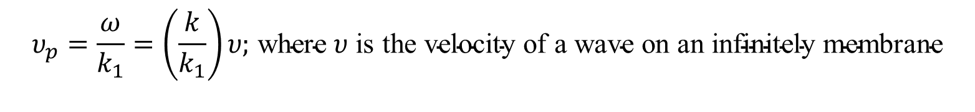
What is the phase velocity of the travelling wave?
Consider the travelling wave on the membrane from previous slide
The phase velocity of the wave is given as
Because , this can be rewritten as
Since k₁ must be real for the wave to propagate, thus
$$υ_{p}=\frac{ω}{k_{1}}=\left(\frac{k}{k_{1}}\right)υ\text{;} \text{where} υ \text{is} \text{the} \text{velocity} \text{of} \text{a} \text{wave} \text{on} \text{an} \text{infinitely} \text{membrane}$$

Slide 24

Allowed frequencies of travelling wave
From the condition and
The allowed frequencies of travelling wave propagating along the membrane is found to be
Where n defines the mode number in the y direction and the membrane acts as a waveguide.
$$ν≥\frac{nυ}{2b}$$
This also represent a cut-off frequency for each mode number n indicating that the waveguide acting as a frequency filter.
Notes:
Cut off frequency ในที่นี้บอกถึงค่าความถี่ต่ำสุดของ wave ที่สามารถ propagate ไปบน membrane นี้ได้

Slide 25
Waveguide membrane
This term expresses the variation of amplitudes across the y direction.
Variation of amplitude with y direction for two dimensional wave propagating along the membrane. Normal modes (n = 1, 2 and 3 are shown) are set up along any axis bounded by infinite impedances.

Slide 26
Optoelectronics & Photonics: Principles & Practices
by Safa O. Kasap

Slide 27
Optoelectronics & Photonics: Principles & Practices
by Safa O. Kasap
;d = 2a
Notes:
TIR = total internal reflection

Slide 28
Optoelectronics & Photonics: Principles & Practices
by Safa O. Kasap

Slide 29
Optoelectronics & Photonics: Principles & Practices
by Safa O. Kasap

Slide 30
Optoelectronics & Photonics: Principles & Practices
by Safa O. Kasap

Slide 31
Optoelectronics & Photonics: Principles & Practices
by Safa O. Kasap

Slide 32
Example : a number of modes
Planar dielectric waveguide : a = 50 μm, n₁ = 1.490, n₂ = 1.470 and λ = 1 μm
Determine the highest mode m supported by the waveguide and how many modes can be supported by the waveguide?
Notes:
The highest mode m is 48 and there are 49 modes supported by the waveguide for TE or TM mode.

Slide 33
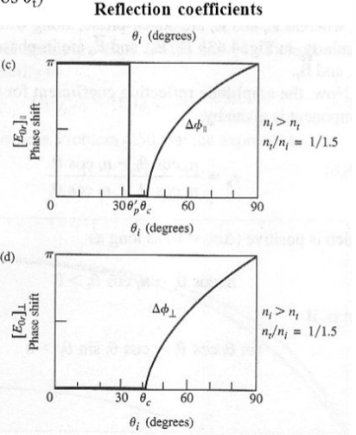
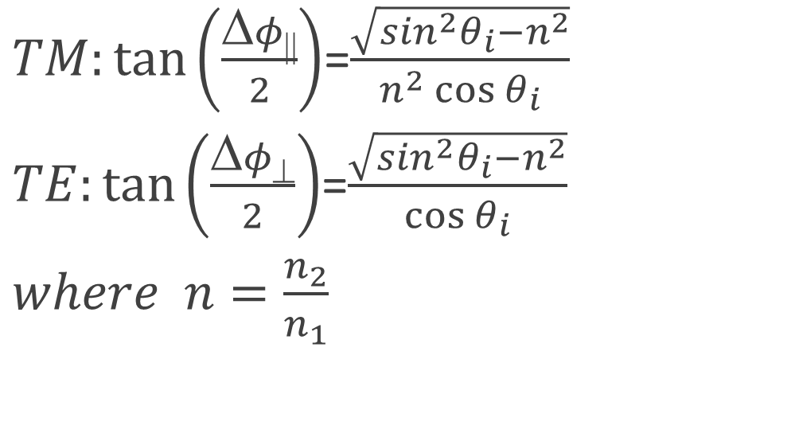
Phase shift due to total internal reflection
$TM:\tan\left(\frac{Δφ||}{2}\right)$=$\frac{\sqrt{\sin^{2}θ_{i}−n^{2}}}{n^{2}\cos{θ_{i}}}$
$TE:\tan\left(\frac{Δφ⊥}{2}\right)$=$\frac{\sqrt{\sin^{2}θ_{i}−n^{2}}}{\cos{θ_{i}}}$
$where n=\frac{n_{2}}{n_{1}}$
https://slideplayer.com/slide/4645556/

Slide 34
Optoelectronics & Photonics: Principles & Practices
by Safa O. Kasap

Slide 35
Reflection and transmission of a three-dimensional wave at a plane boundary

Slide 36
Total internal reflection and evanescent waves
Consider the propagation of an electromagnetic wave across the boundary between dielectric into air.
Total internal reflection can take place but boundary conditions still require a transmitted wave known as the evanescent or surface wave.
The wave propagates in the x direction but its amplitude decays exponentially with z.

Slide 37
Transmitted wave as the evanescent wave
Consider in terms of the transmitted electromagnetic wave that satisfies the boundary condition E_{i} + E_{r} = E_{t}.
Because
Which for θ > θ_{c} gives sinθ > n_{r} so that

Slide 38
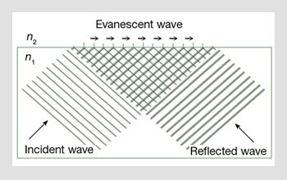
From the last slide
We also have
The transmitted wave becomes
Absorption in z direction
Propagation in x direction
Only negative sign of the amplitude exponential function has a physical meaning.
https://www.osa-opn.org/home/articles/volume_20/issue_2/features/reflections_on_total_internal_reflection/

Slide 39
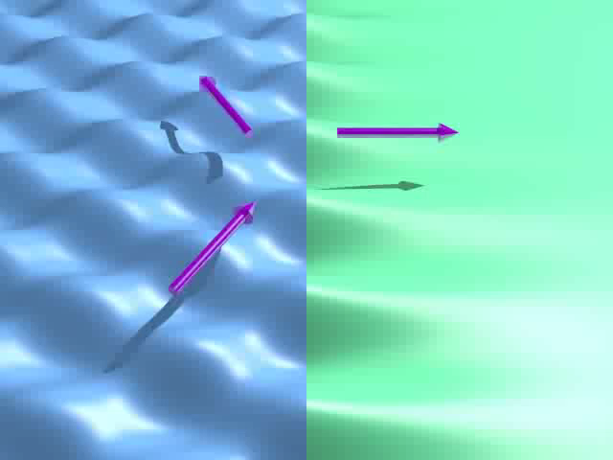
Evanescent wave
The disturbance travels in the x direction along the interface.
The penetration depth depends on the refractive indices, the incident angle and the wavelength of the EM wave.
https://www.youtube.com/watch?v=KYwacKlfEpU

Slide 40

Frustrated total internal reflection
If only a very thin air gap exists between two glass blocks, it is possible for energy to flow across the gap allowing the wave to propagate in the second glass block.
The process is called frustrated total internal reflection.
https://www.youtube.com/watch?v=fOqF6t6A4O4

Slide 41
Homework # 9

